Slide 1
Civic Tech and LoRaWAN Hackathon for a better city

Slide 2


What is this?
We are bringing together the local maker community and the city administration to explore new ways of solving problems of our city with the help of open networks and civic tech.
Creative problem solving party
Maker days | Hackdays | Hackathon

Slide 3
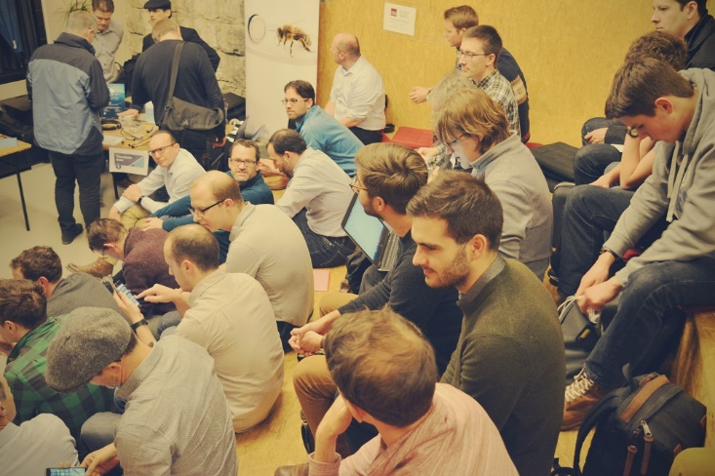
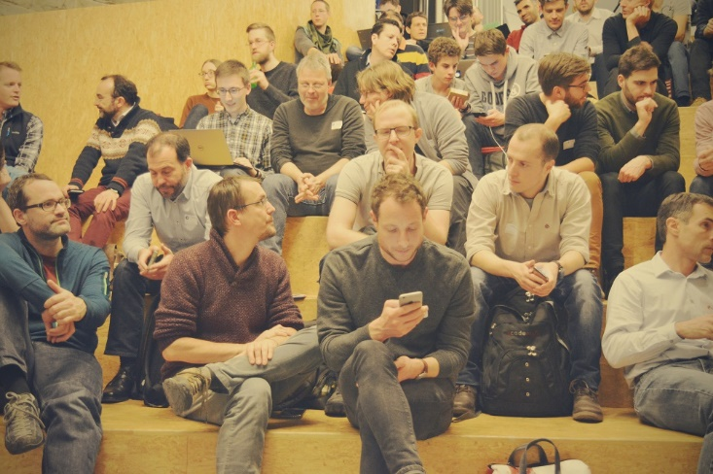

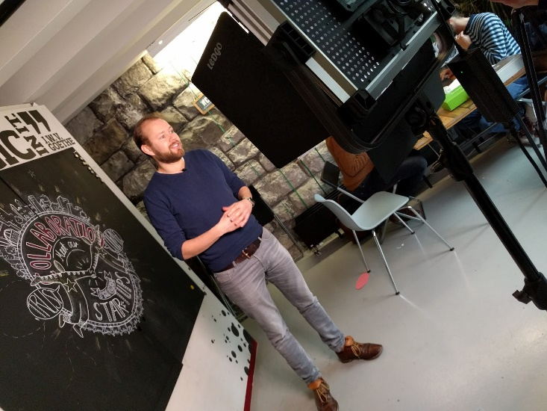
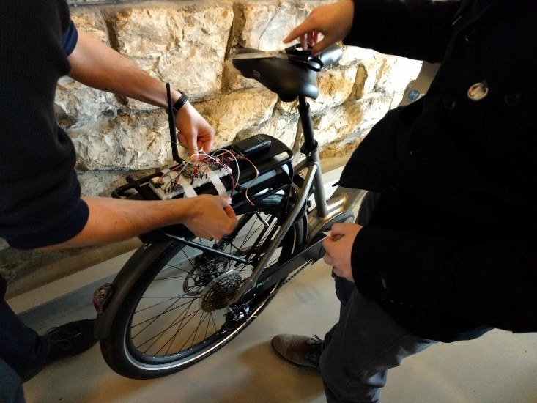
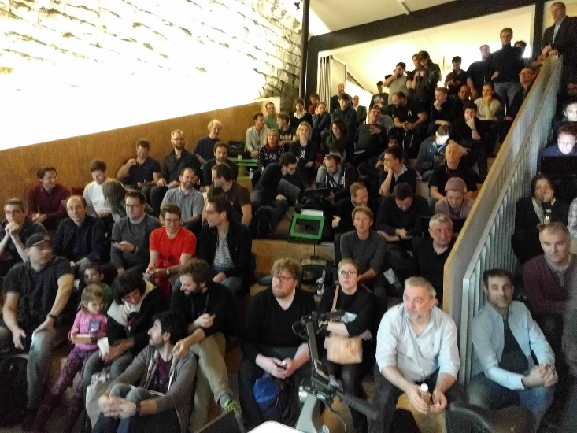
Make Zurich 2017
Notes:
January February 2017

Slide 4
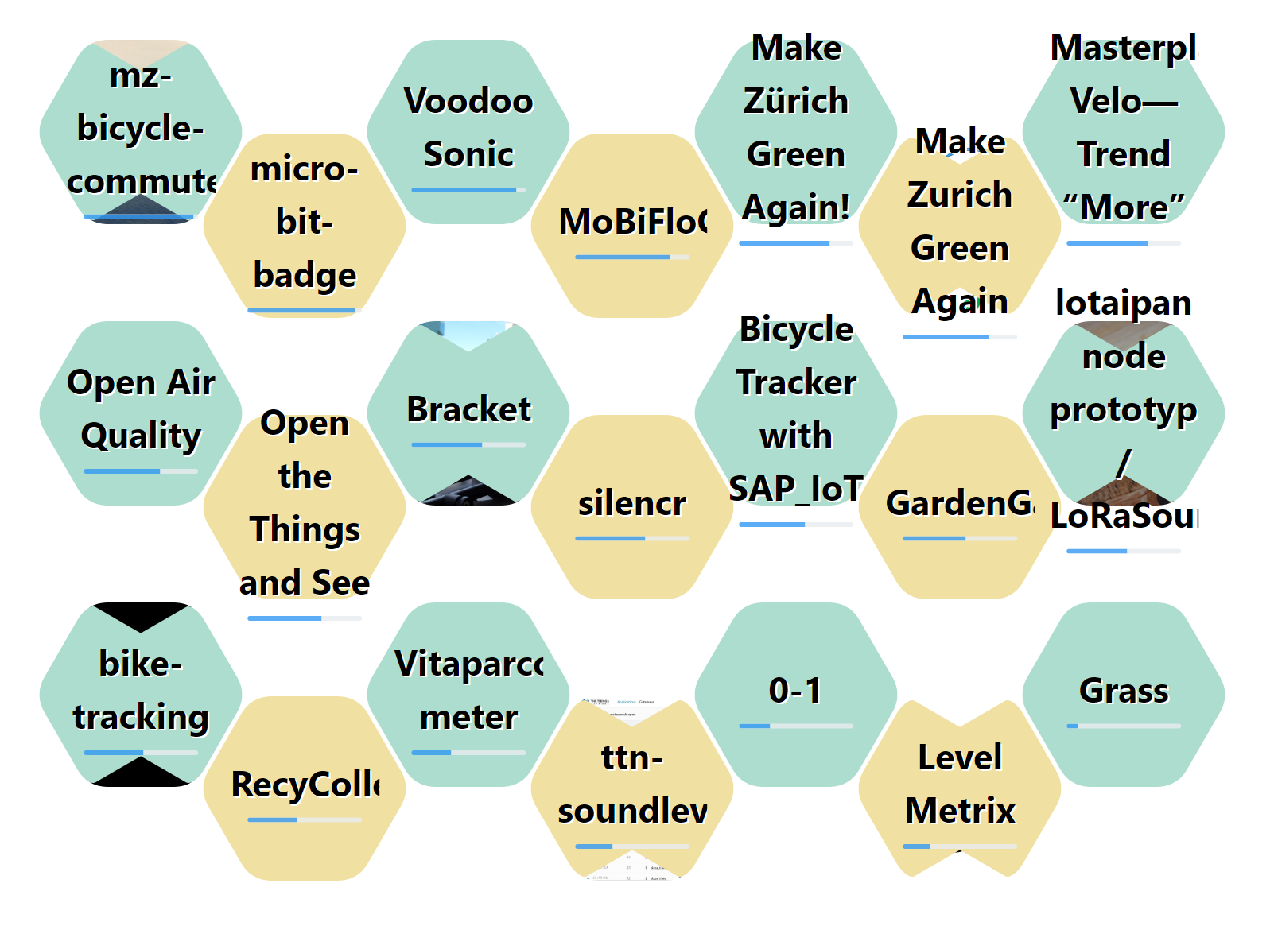
Make Zurich 2017
Notes:
7 challenges
17 teams
70+ participants

Slide 5
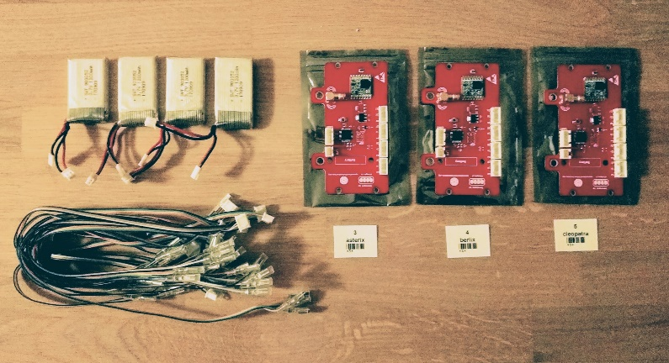
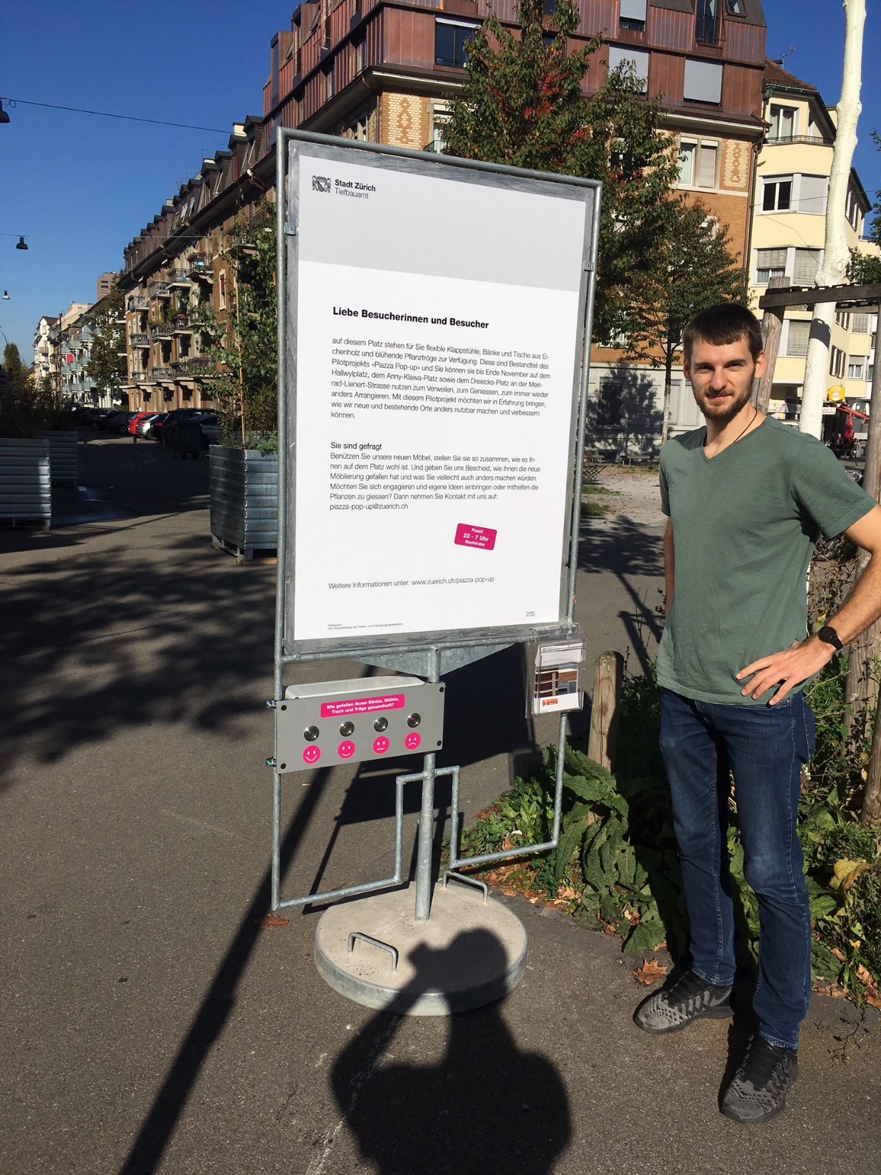
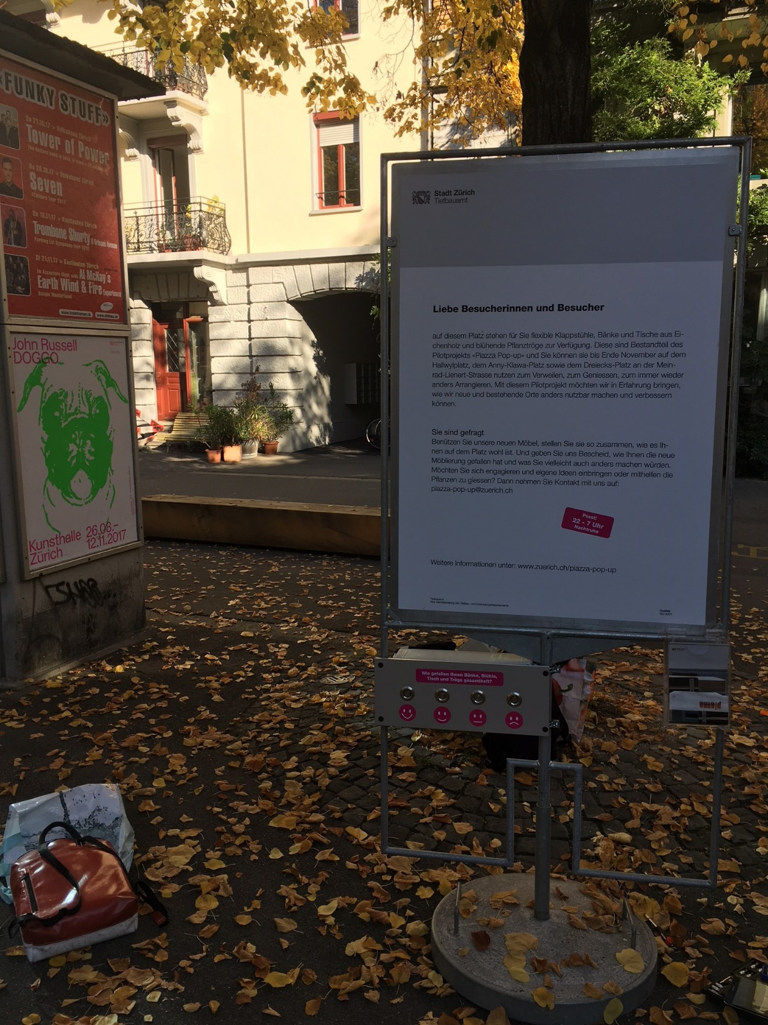
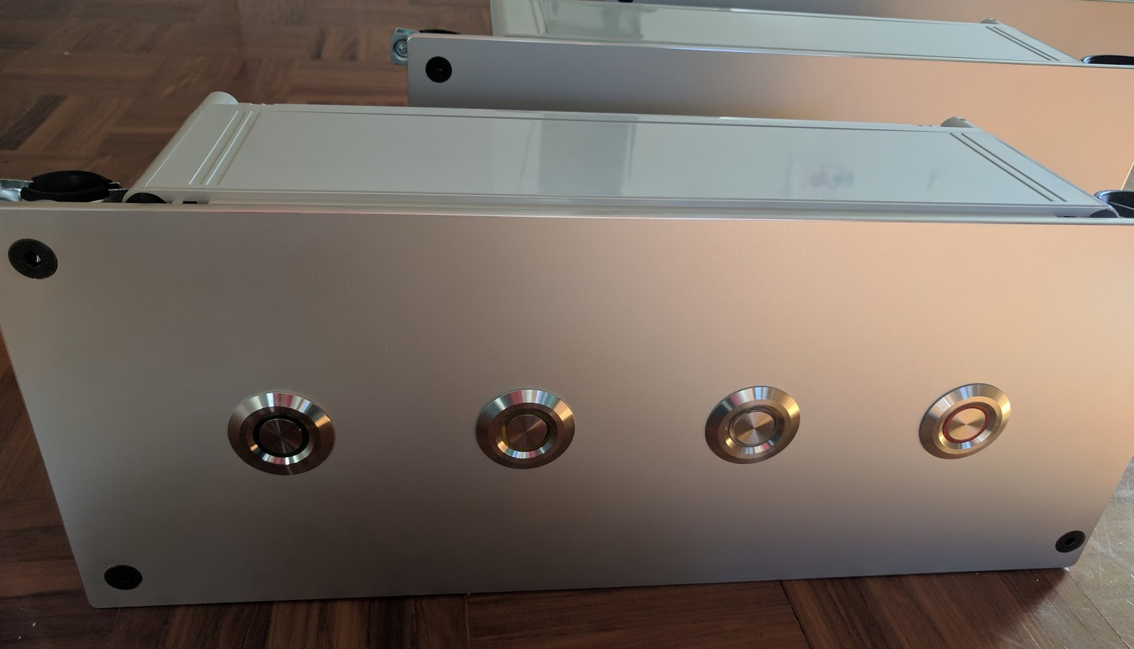
Make Zurich 2017
TAZ + Community collaboration: Piazza Pop-up
Notes:
Follow up: cooperation with Tiefbauamt Zurich.
Creating rating buttons for a project on public squares all over the citz
They’re superhappy with the solution and are not shy mentioning the cooperation whenever possible to departements

Slide 6
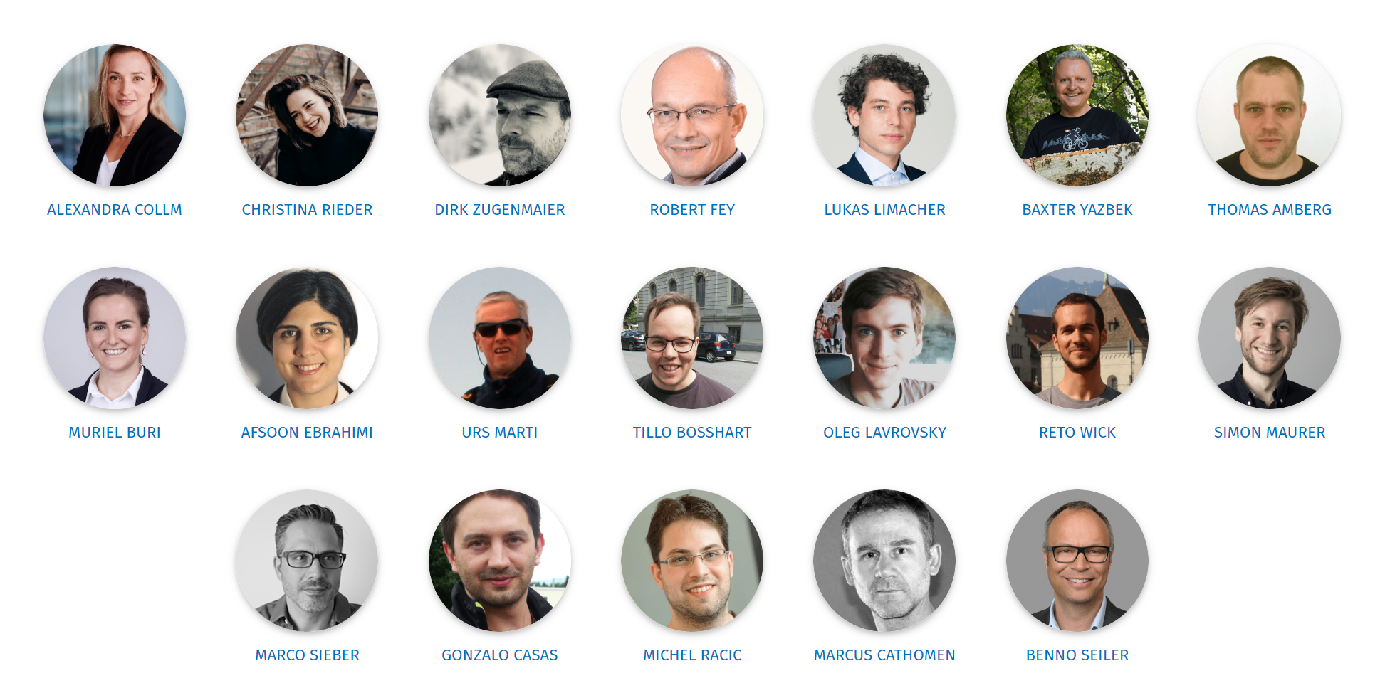
Who are we?

Slide 7

Sponsors and partners

Slide 8

Community partners

Slide 9
Kick-off: June 22nd 2018
17:00 Open Doors
18:00 Introduction to #MakeZurich
18:15 Presentation of seven challenges
19:00 Team registrations and Q&A sessions with
challenge stakeholders, sponsors and partners
19:45- Apéro!

Slide 10
Challenges
Seven
For a smarter city
Aka, why are we here tonight?

Slide 11

Real time Occupancy rate
1
CHALLENGE
Discover ways to use technology to measure and understand occupancy rate of the public transport vehicles in real time.
Provided by VBZ
Peggy Neubert
Head of Service Quality, VBZ
Mail: peggy.neubert@vbz.ch
Phone: 044 411 4632

Slide 12
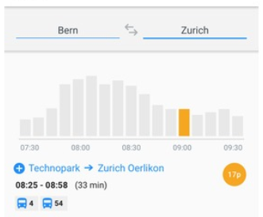
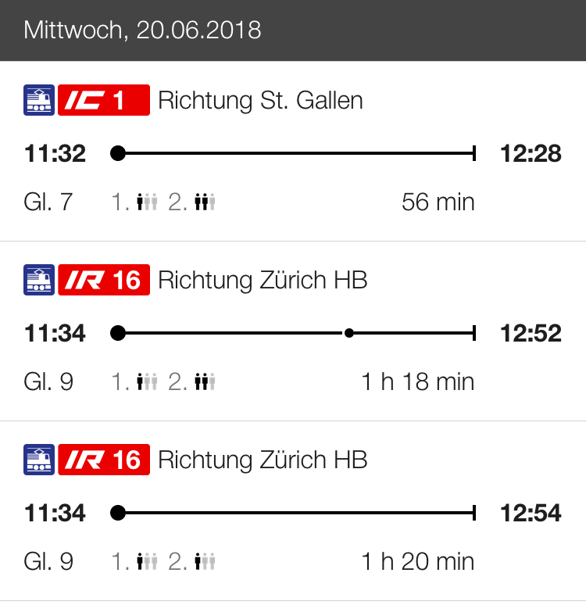
Problem statement
Today only 20% of our vehicles are equipped with counting sensors. The occupancy rate will be available days later. For future applications we need this information for all vehicles in real time. If the information of the occupancy rate is combined with the timetable, commuters may change their travel behavior and use less crowded vehicles.

Slide 13






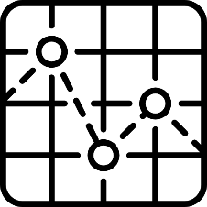

Ideas & Hints
Seats
Different types of
vehicles
Vehicle Location
Weight
Parking place
Standing places
Route Stop sequence
Mobile devices
Contact:
Peggy Neubert, peggy.neubert@vbz.ch, 044 411 4632,
Available Tue – Thur (9 a.m. – 4 p.m)
Visit Pitch 29.06.: Thomas Hollenstein + Daniel de Jong

Slide 14
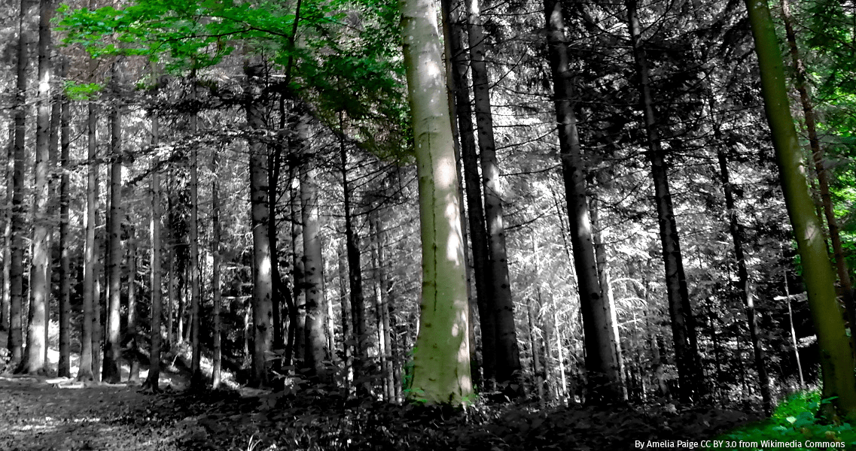
City Forest Visitors
2
Challenge
All year round, the forests of the city of Zurich receive thousands of visitors. How can we assess and quantify them easily and efficiently?
Provided by Grün Stadt Zürich
Regina Wollenmann / Marvin Bürgin
Forest management
Grün Stadt Zürich
marvin.buergin@zuerich.ch

Slide 15
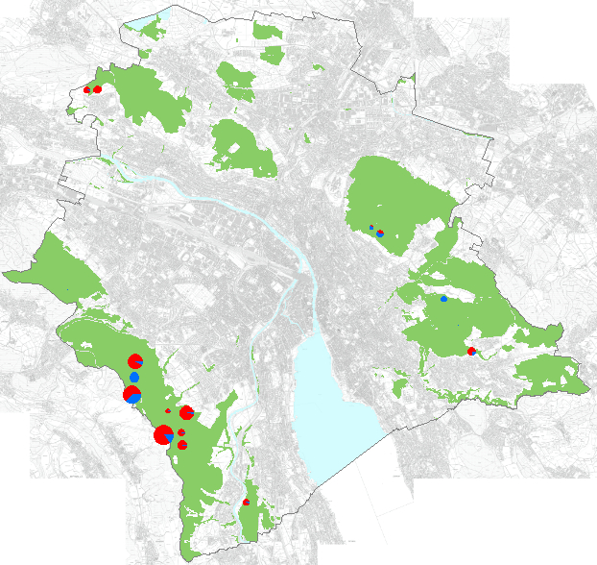
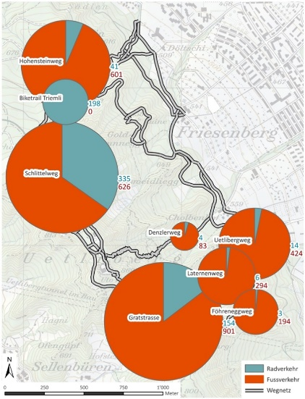
Problem Statement
We know:
Forest area: 2232 hectares
Around 642 forest entry points
230 kilometer forest roads and paths
Diverse user groups
Pedestrians (incl. Geocachers, Nordic Walkers)
Cyclists
Mountainbikers
Runners
Forest Kindergarten
Dog Owners
We guess:
More than 1’500’000 visits per year

Slide 16
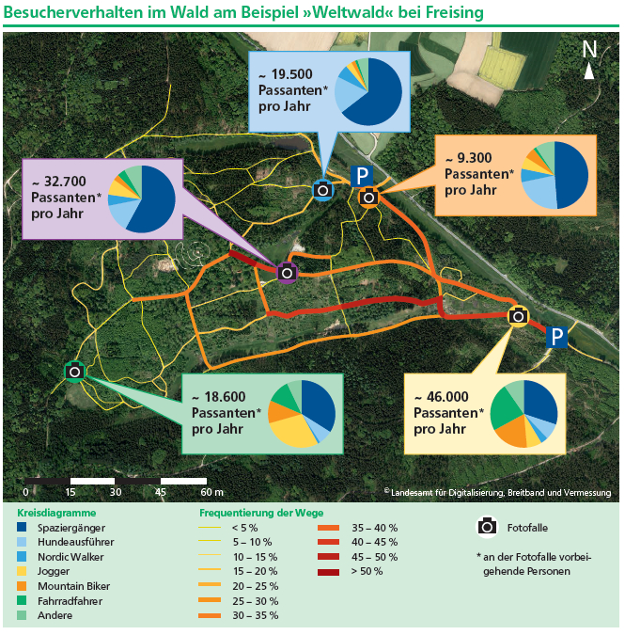
Problem Statement
We would like to know:
How many visitors do we have?
Where do they go?
Where do they stay?
What activities do they perform?
Source: LWF Merkblatt 39 der bayerischen Landesanstalt für Wald und Forstwirtschaft

Slide 17
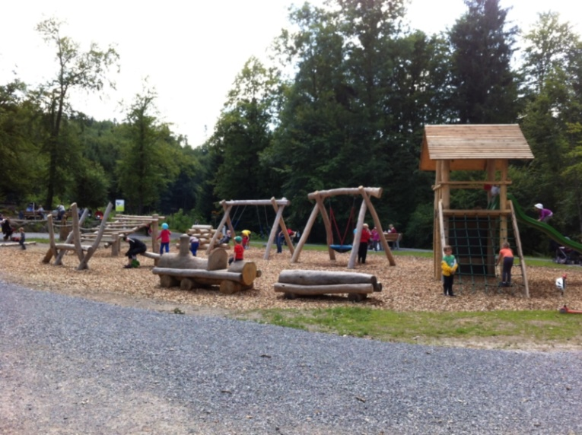
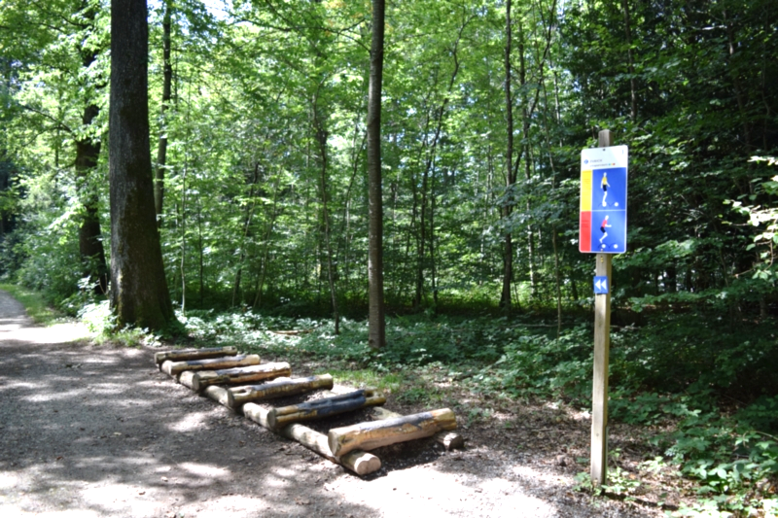
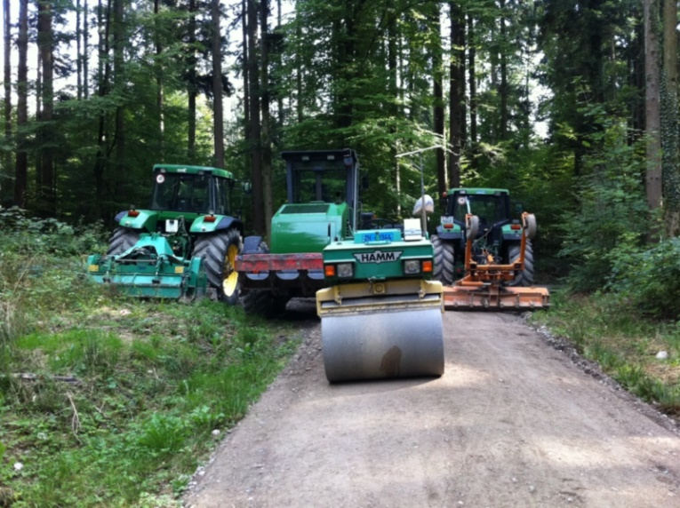
Problem Statement
Why is this of interest?
Putting the right infrastructure in the right place
Optimization of maintenance
Early detection of trends
Early detection of conflict areas
Justification of resources

Slide 18
Available Resources
Data of available sensors (Pedestrians/Cyclists)
Heatmap of Zurich: https://labs.strava.com/
GIS Data:
Forest roads and paths
Forest entries
Recreation infrastructure in the forest (lines and points)
Constraints:
Sensors (robust/energy source/wireless data transfer)
Number of forest entries
Accuracy/costs
Data laws e.g. Federal Act on Data Protection: https://www.admin.ch/opc/en/classified-compilation/19920153/index.html

Slide 19
Ideas & Hints
Video evaluation
Strava-App Data https://www.strava.com/features
Other Apps?
Mobile phone tracking
Evaluation of App/Mobile-Data in small forest part, control with sensors => Optimization of infrastructure
Extrapolation of data? Creation of a data model?
Classification of visitors via movement speed?
Creation of Heat-Map/Length of stay
Contact: Preferably by email
marvin.buergin@zuerich.ch
Office hours 8-17, Tel.: 044 412 42 75

Slide 20
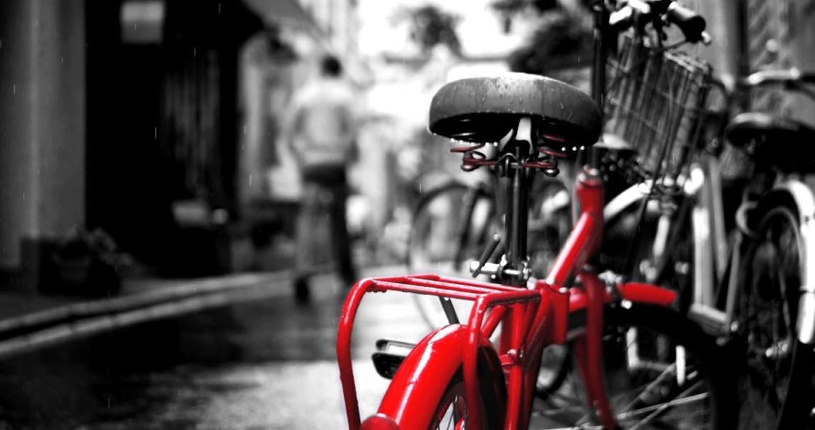
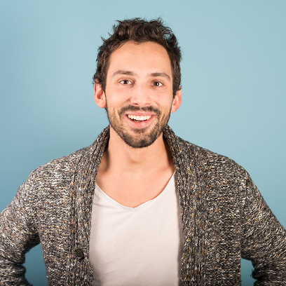
No Bike Left Behind
3
CHALLENGE
How can we track and recover abandoned bikes from the stationary sharing system of Züri Velo?
Provided by PubliBike
Thomas Hug
Location manager
PubliBike
thomas.hug@publibike.ch

Slide 21
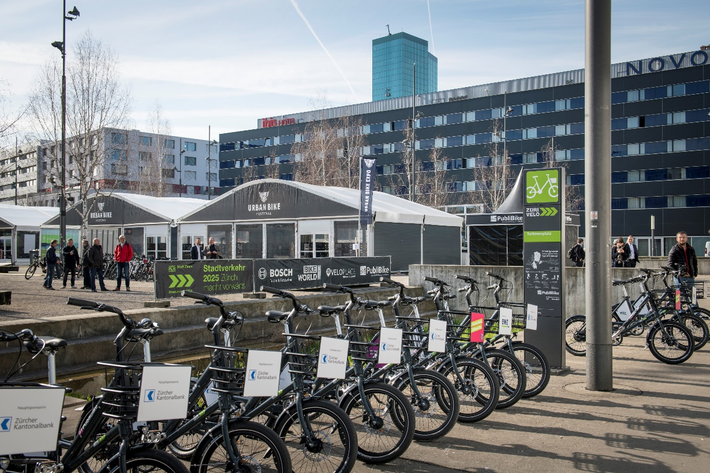
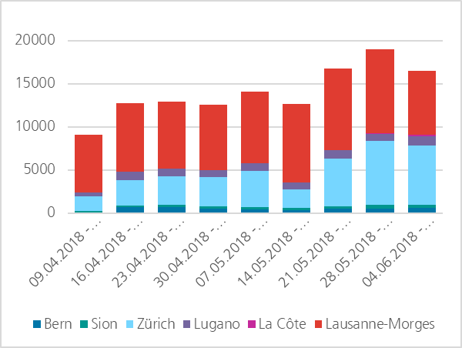
Problem Statement
Bikes get lost. But we like our bikes! We don’t want them to get lost.
How can we get them back?

Slide 22
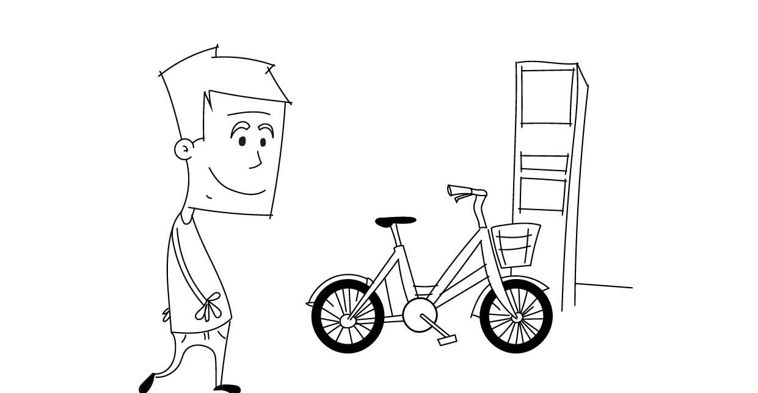
Available Resources
Our bike. You can open the lock using any RFID-card. Take care of it – it would like to go riding again after the event.
Constraints:
Easily mounted on both bikes (ebike and mechanical)
Barely any additional battery and operational needs
Vandal-proof

Slide 23
Ideas & Hints
Use available power (lights)
Hide it well (behind the back light or in the middle section)
Cost assumption is crucial for us ☺ a feasible solution will affect a few 1000 bikes not only in Zurich
Don’t use the ebike battery (obviously there is none on the mechanical bike)
Making changes inside the lock gets very expensive – so better leave it ☺
E-Mail/Slack: thomas.hug@publibike.ch
Phone: +41 76 405 72 12 (I often have meetings where I can’t take calls – so if you’re looking for a quick reply, you’re better off using email or slack).
I’m out of office after Thursday. I will try replying to your questions nevertheless.

Slide 24
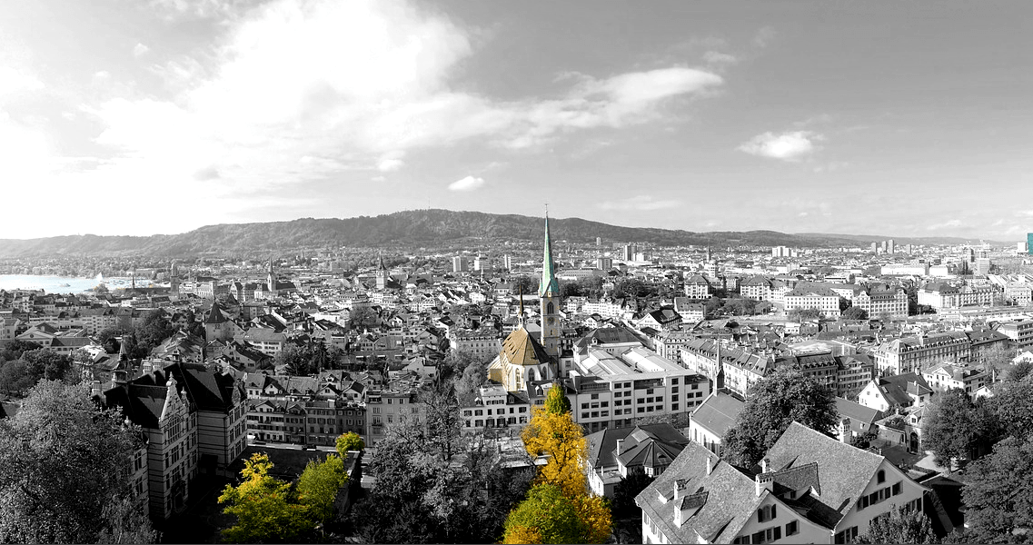
CONQUERING THE LAST MILE
4
4
CHALLENGE
Optimizing last-mile logistics is fundamental topic for a smarter city. How can we measure and visualize deliveries within the boundaries of the city?
Provided by the office for urban development
Simon Keller
Project manager
Office for urban development
simon.keller@zuerich.ch

Slide 25
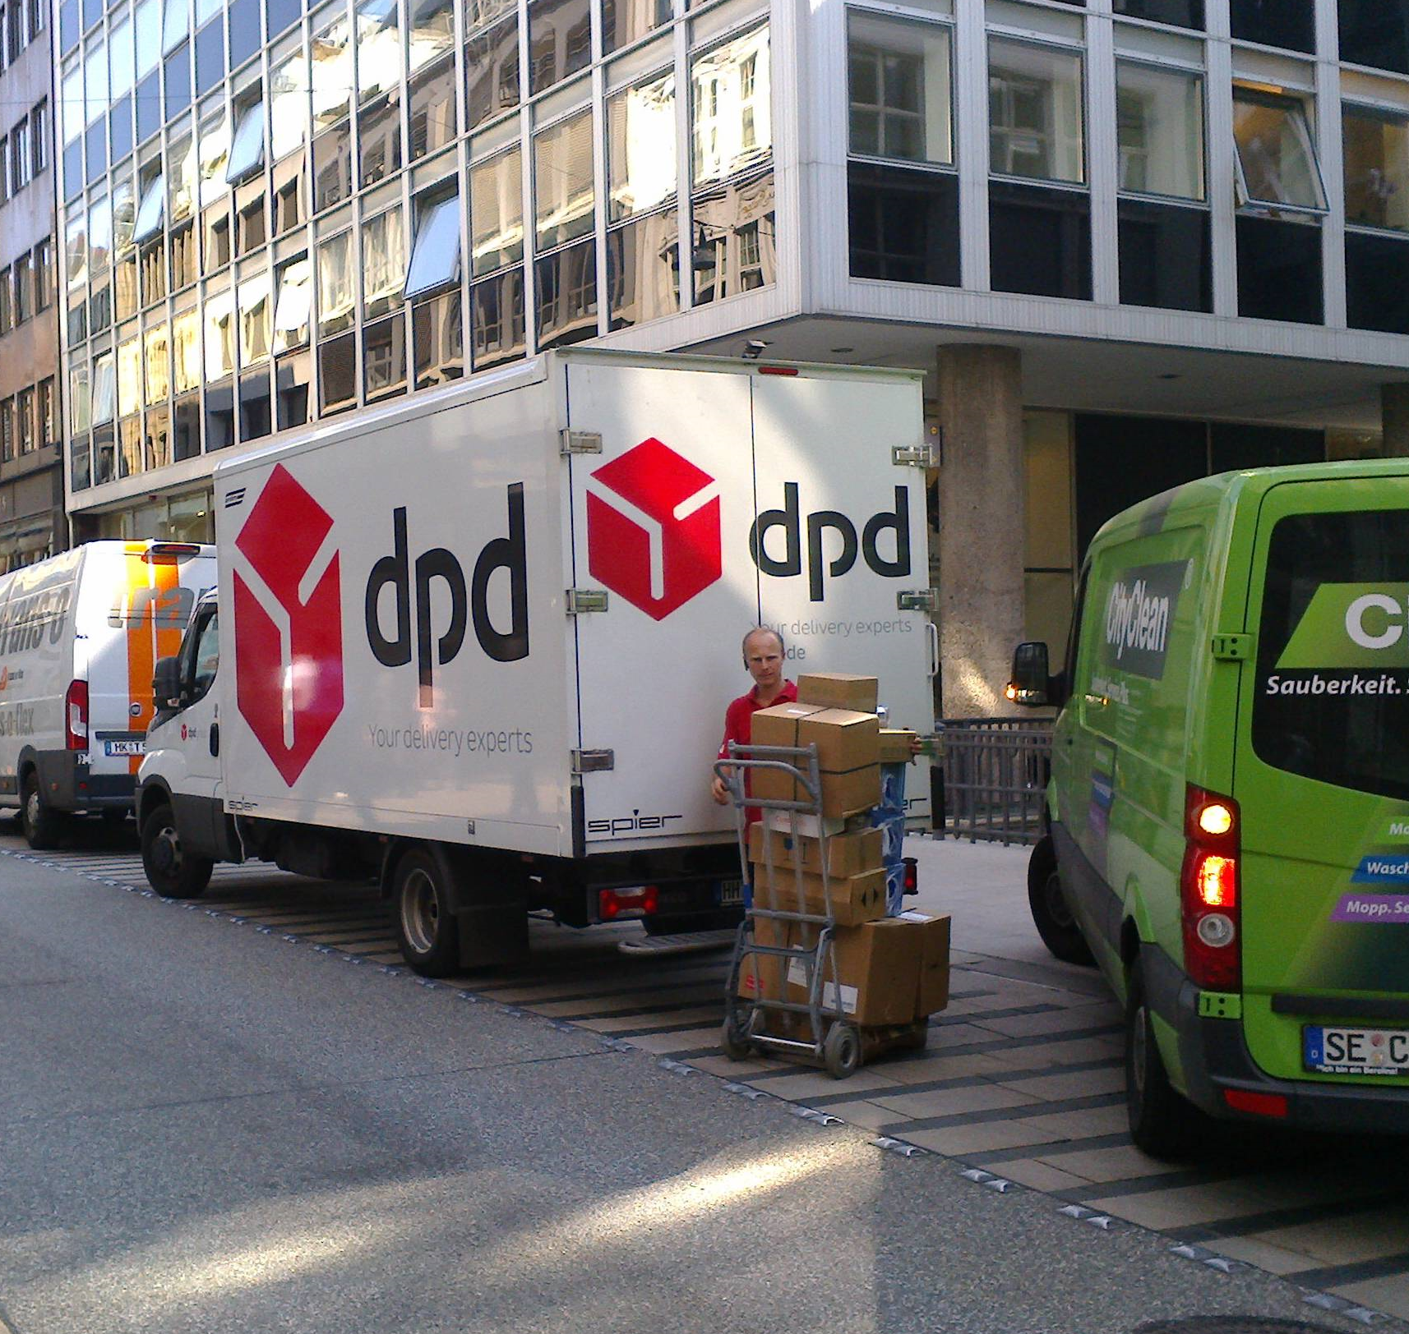
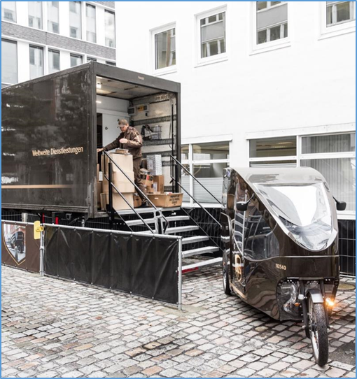
Problem Statement
Due to the increasing volume of home deliveries and a constantly growing population, Zurich is facing the challenge of preventing congestion in their residential districts.
Definition: Last mile delivery is a term used for transportation of goods from the nearest distribution hub to the final destination, such as a home or business.

Slide 26
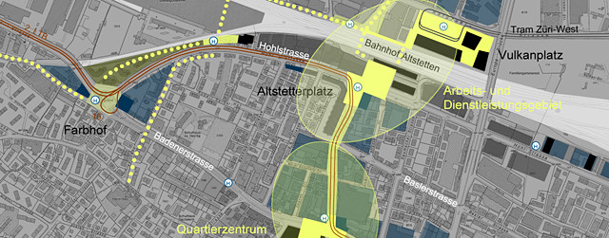
Ideas & Hints (I)
Optimization of last mile routes from the perspective of an urban planner. (e.g. to reduce traffic jams)
Office of Urban Development
Simon Keller
simon.keller@zuerich.ch

Slide 27
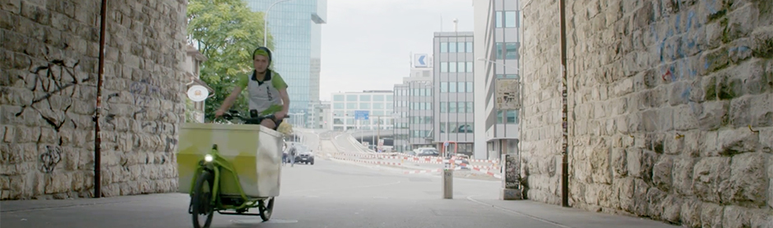
Ideas & Hints (II)
Measuring specific indicators (e.g. temperature) of packages could help to determine quality of delivery of sensitive goods
Measuring package dimensions in order to store them optimally in a delivery center, a micro hub or in the delivery system (e.g. bike trailer) itself
Preventive maintenance for bike couriers
notime
Tobias Rüdlinger
tobias.ruedlinger@notime.eu

Slide 28
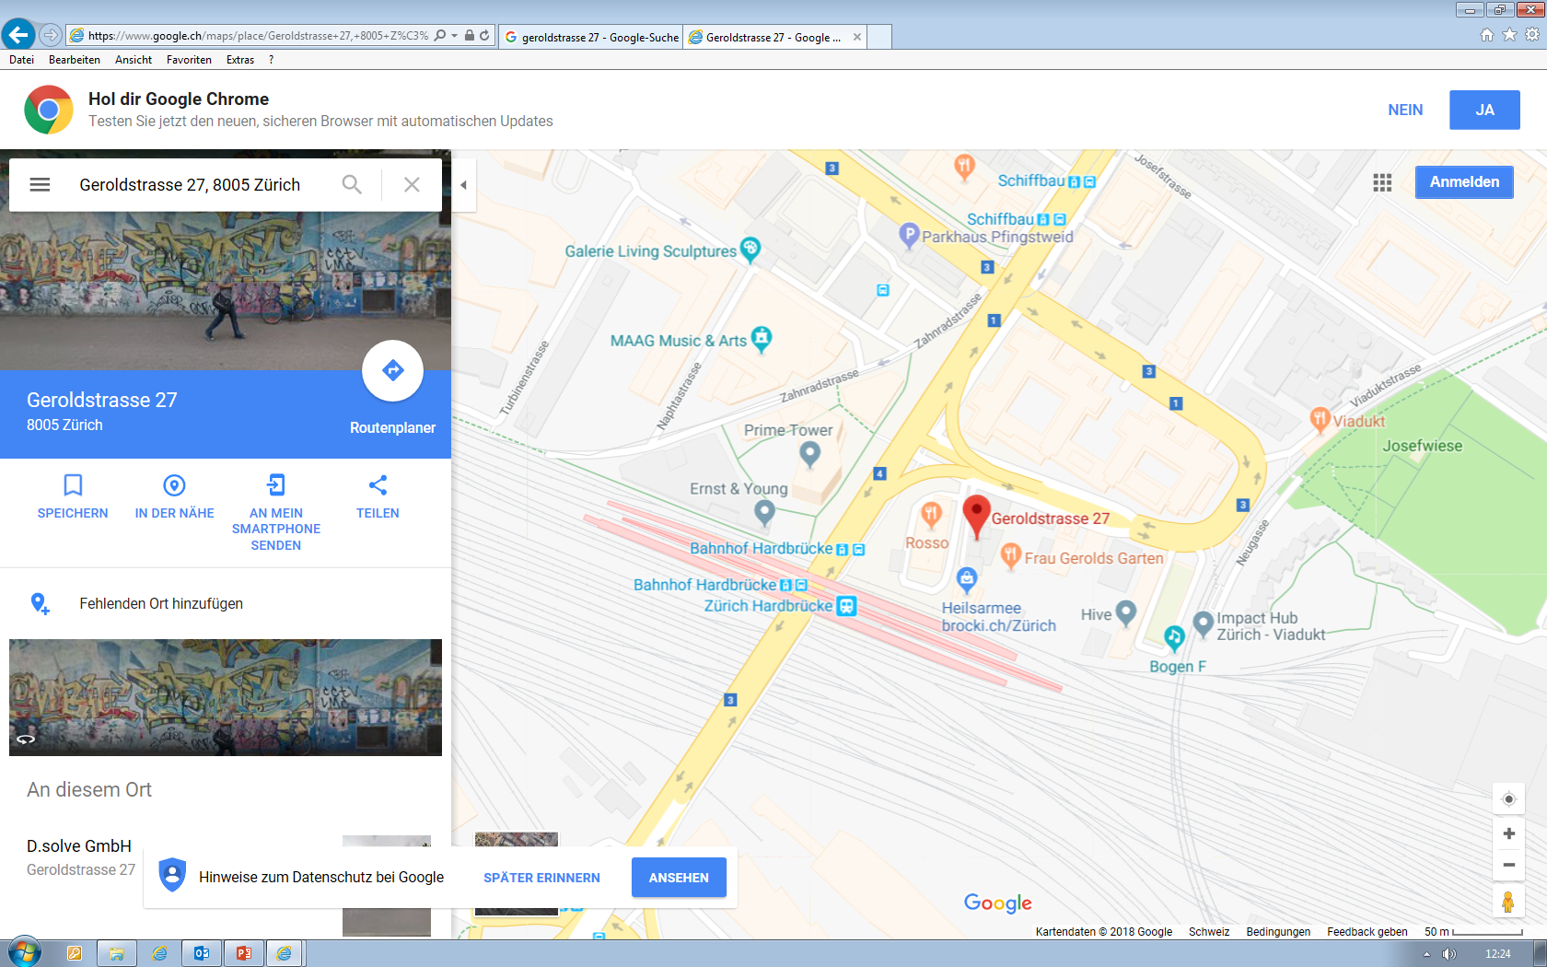
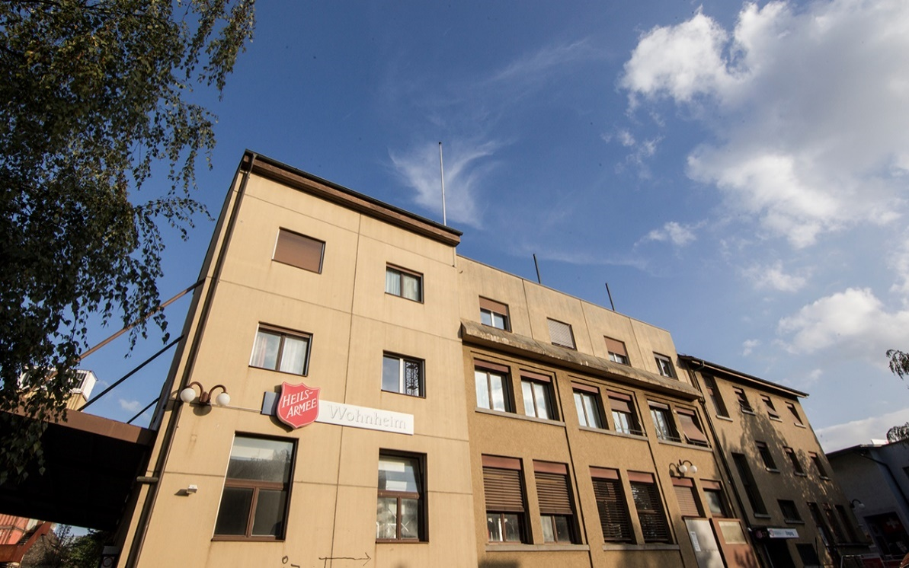
Available Resources
Workshop on Monday, 25th of June at Geroldstrasse 27 from 17:00 – 18:00:
“Inside notime – insights into a urban logistics service provider”

Slide 29
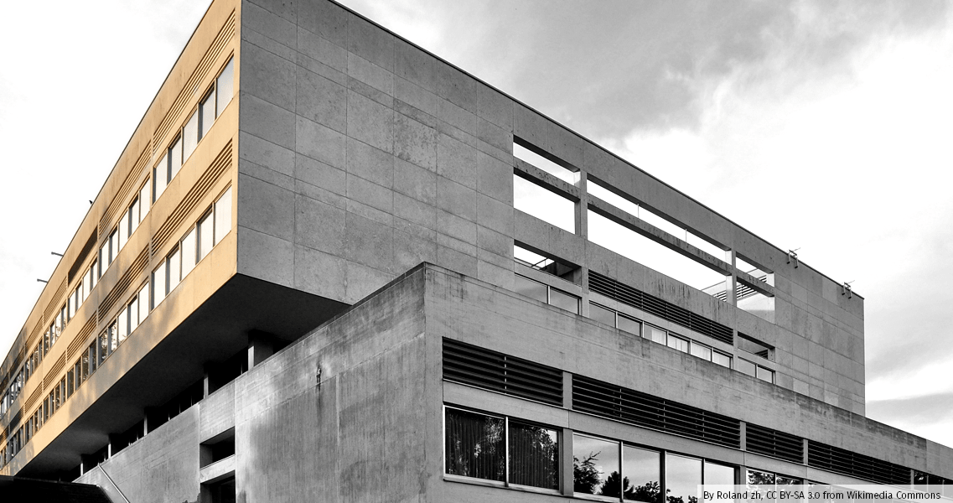
TEACHER’S CALLING
5
CHALLENGE
Creating a system for efficient silent alerts

Slide 30
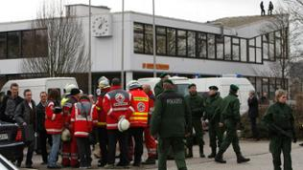
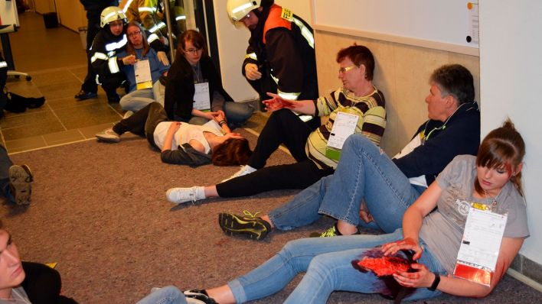
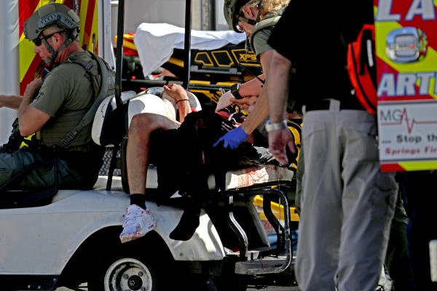
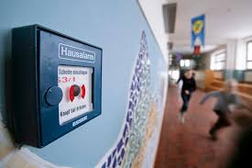
Problem Statement
There is a working procedure in case of an evacuation but not in a case of amok!
How can a silent alarm be triggered?
How can a silent alarm be noticed (local)?
How can a silent alarm be noticed (externally)?
How can a silent alarm be trained?

Slide 31
Available Resources
Schoolhouses with different rooms (there are over 100 schoolhouses only in Zurich)
Gong systems
Constraints:
Cellphones are not allowed in the classrooms for the students and in the primary school the kids don’t have a cellphone
The teachers have the focus not on their cellphone (hopefully) and so is the cellphone solution a high risk

Slide 32
Ideas & Hints
When the silent alarm is activated, it should be visible on the classroom with a red light turning on every classroom when the alarm is activated (it must be visible for teacher and students)
When the silent alarm is activated is concurrently the alarming of the blue light organization

Slide 33
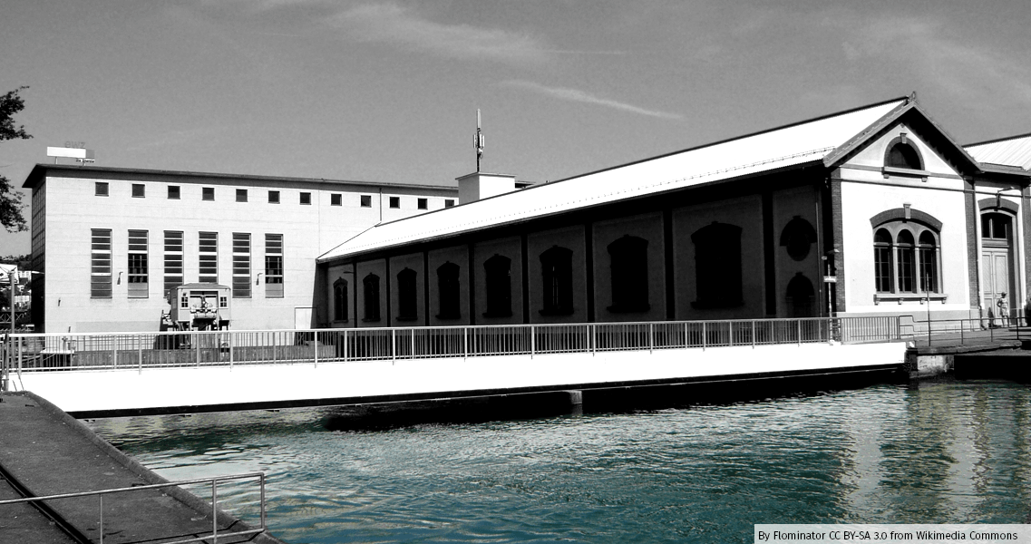
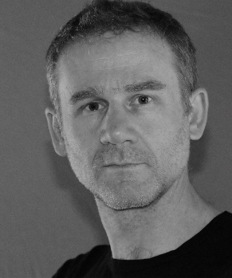
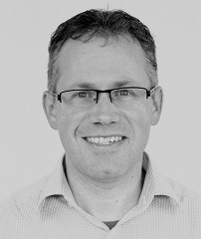
Distribution Grid Power Failure
6
CHALLENGE
How can we improve the detection of power failures in the low voltage network for a more efficient city?
Provided by ewz
Marcus Cathomen
Ferni Donzé
Innovation Project Manager
Corporate and Business Development
marcus.cathomen@ewz.ch
+41 76 232 82 82
Project Planning Manager
Distribution Grid
fernand.donze@ewz.ch
+41 79 412 30 65

Slide 34
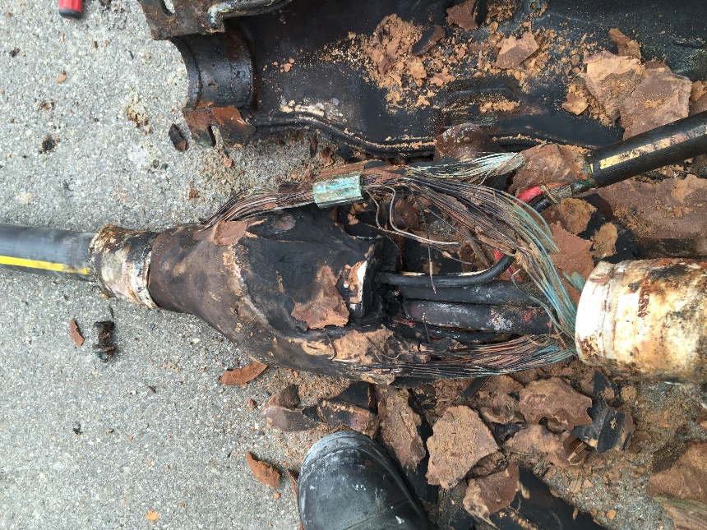
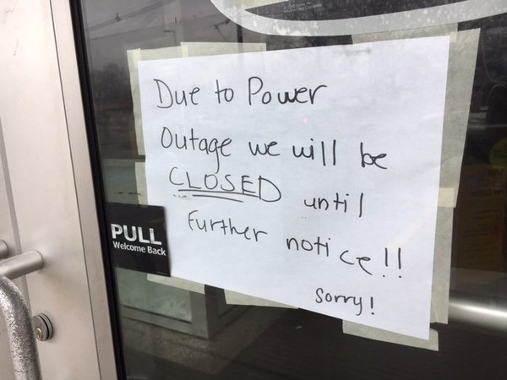
Problem Statement
A power failure in the low voltage grid (400V and 230V) is not automatically detected.
Measures to remedy power failures can often only be initiated after an affected end customer has contacted ewz.
Today ewz customers can contact the ewz 7x24 helpdesk (+41 58 319 40 30 or 7x24stunden@ewz.ch).

Slide 35
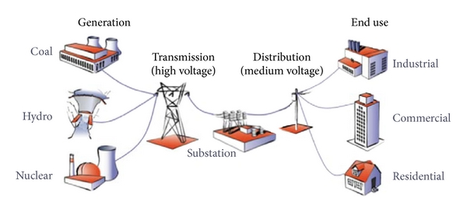
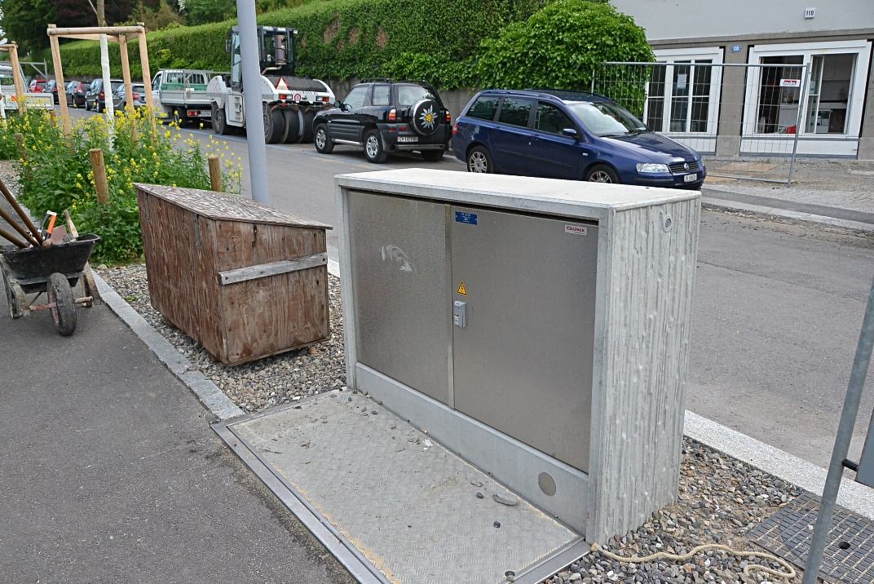
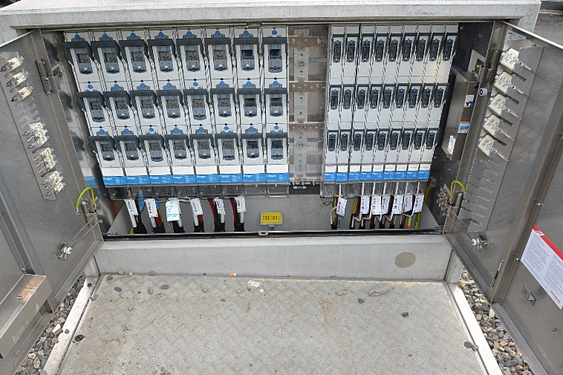
Available Resources
City of Zurich
~ 200’000 Housholds
~ 45’000 Companies
~ 55’000 Buildings
~ 2000 distribution cabins
Distribution grid failures
in Ø one failure in 1 to 2 weeks
Main reasons for power failures
Damage caused by third parties like civil engineering work, excavators, etc.
Damage caused by technical failure, weather influences, etc.
distribution cabin

Slide 36
Ideas & Hints
distribution cabin
Challenges
Up to 40 runoffs in one cabin that might have to be monitored (prototype for 1 runoff might be fine)
Fault message contains runoff ID and time stamp of the fault
Fault message visible in the management system after 5 seconds
Limited space: max. 10 x 20 x 70 cm
Limited costs: max. CHF 100 per cabin
fuse
L1
access
L2
L3
PEN
power failure detection
Ideally a power failure is being detected automatically at the power distribution runoff, then the failure is processed and a message is send via LoRa to the ewz management system.
fuse
power failure detection
runoff
Legend:
L1, L2, L3: phases
PEN: Protective Earth and Neutral (must not be interrupted)
notification via LoRa

Slide 37
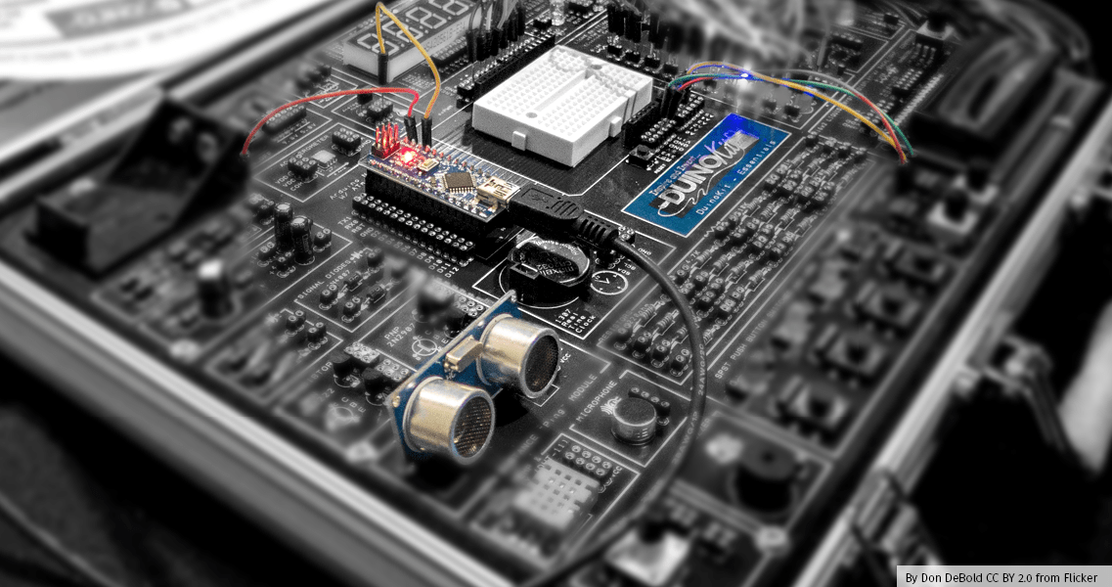
Open Challenge
7
CHALLENGE
If none of the challenges fits you, you are free to combine all available elements and develop your own challenge and ideas!
Provided by you!
Gonzalo Casas
The Things Network Zürich
gonzalocasas@gmail.com

Slide 38
Ideas & Hints
Check the open challenge ideas contributed by the community:
https://github.com/make-zurich/open-challenge-ideas
If you have new ideas, add them to the repository.

Slide 39


Slide 40
Time to team up!
Visit challenge rooms
Decide for a challenge
Find team mates
Register your team
Get the challenge kits

Slide 41
Time to team up!
Visit challenge rooms
Decide for a challenge
Find team mates
Register your team
Get the challenge kits

Slide 42

Time to team up!
Visit challenge rooms
Decide for a challenge
Find team mates
Register your team
Get the challenge kits

Slide 43
Time to team up!
Visit challenge rooms
Decide for a challenge
Find team mates
Register your team
Get the challenge kits

Slide 44
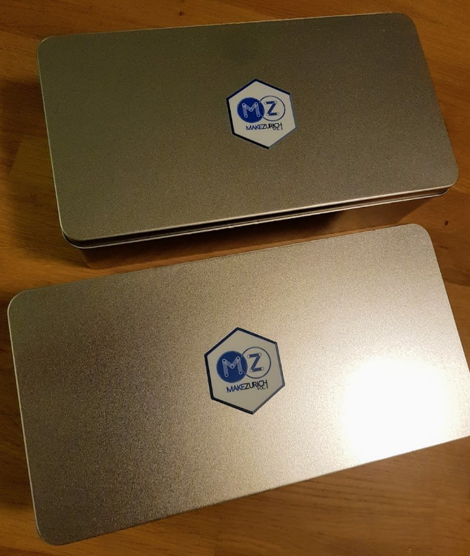
Time to team up!
Visit challenge rooms
Decide for a challenge
Find team mates
Register your team
Get the challenge kits

Slide 45
Open Lab Week
Saturday 23rd until Thursday 28th

Slide 46
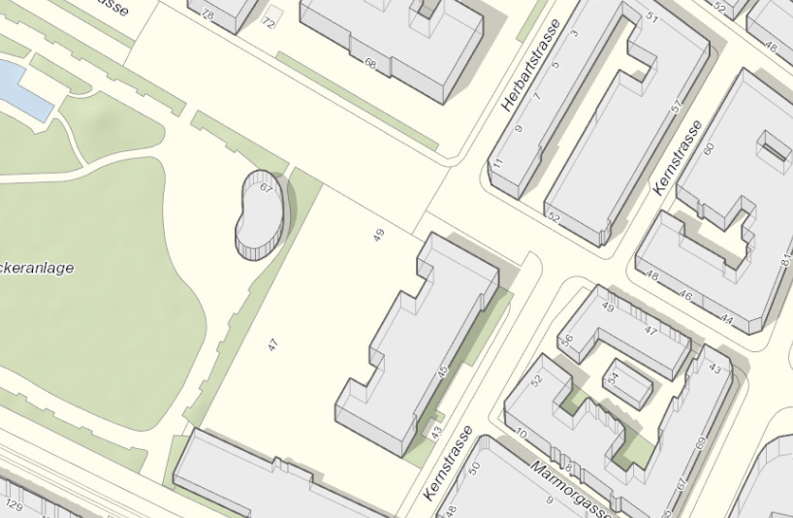
Open Lab Week @ MechArtLab
Mentoring and assistance
Available tools
Workshops
Good conversation!
Saturday 23rd until Thursday 28th:
16:00 – 22:00
Hohlstrasse 52, 8004 Zürich

Slide 47
Hack days
Friday 29th and Saturday 30th

Slide 48
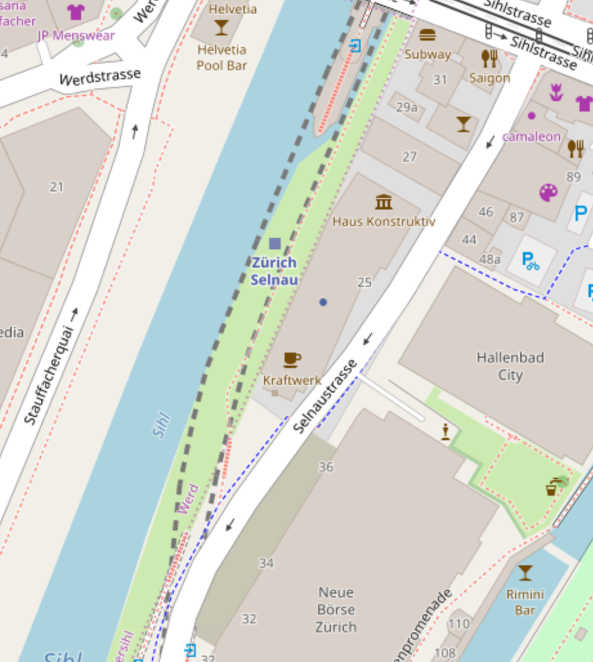
Hackdays @ Kraftwerk
Friday 29th
09:00 Open Doors
Saturday 30th
15:30 Final submission time
16:00 Presentations
18:00 Apéro
Selnaustrasse 25, 8001 Zürich

Slide 49






Hackdays @ Kraftwerk

Slide 50
Make zurich IoT platform
Provided by Hivemind AG

Slide 51

Make Zurich Iot Platform

Slide 52

platform.makezurich.ch
Register

Slide 54

Be excellent to each other!
Code of Conduct

Slide 55
And now what?

Slide 56



now.makezurich.ch
#MakeZurich

Slide 57
Thanks!

Slide 58
Thanks!

Slide 59
Civic Tech and LoRaWAN Hackathon for a better city

